Slide 1
Presentation On
Driver’s Drowsiness Detection

Slide 2
Group Member :
Shraddheya Kadam
Suraj Mane
Omkar Thakare
Amol Gole
Project Supervisor :
Prof. Deepak Kurule

Slide 3
Content :
Introduction
Technology Used
System Development
Test
Conclusion
Future Scope

Slide 4
Introduction
Drowsiness is the state of feeling tired or sleepy. We all can be victim of drowsiness while driving, simply after too short night sleep, tired physical condition or during long journeys.
This Causes the vehicle accident while driving.
Need :-
Various studies have suggested that around 30-40 present of read accident causes due to drivers drowsiness.
Here our system work on the image processing which help us to find the driver is sleeping or not, when driver is sleeping it give warning to driver to take some rest.

Slide 5
Technology Used
Python :- Python is the Basis of the program that we wrote. It utilizes many of the python libraries.
Image Processing:- Image processing is a method to perform some operation on an image, In computer science, digital image processing is the use of computer algorithm to perform image on digital image.(OpenCV)
Hardware :- Raspberry Pi 4, Raspberry pi camera module ,Laptop.

Slide 6
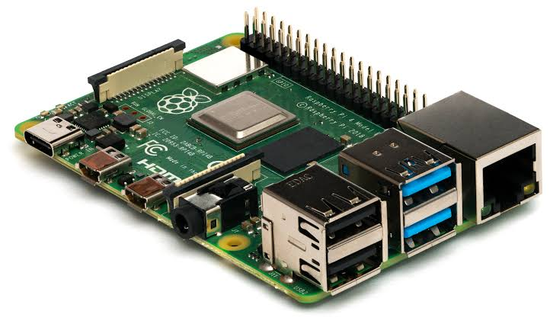
Raspberry Pi:- The Raspberry Pi is a low cost, credit-card sized computer that plugs into a computer monitor or TV, and uses a standard keyboard and mouse. It is a capable little device that enables people of all ages to explore computing, and to learn how to program in languages like Scratch and Python.

Slide 7
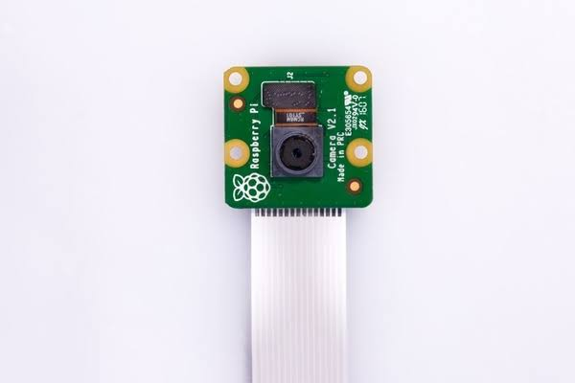
Raspberry pi camera module:- The Pi camera module is a portable light weight camera that supports Raspberry Pi. It communicates with Pi using the MIPI camera serial interface protocol. It is normally used in image processing, machine learning or in surveillance projects.

Slide 8
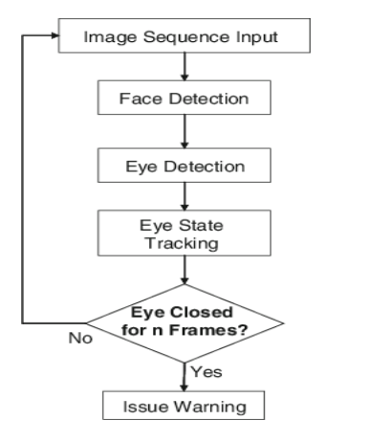
System Development
Our system uses an algorithm to locate, track,
and analyze both the driver’s face and eyes.
Our developed system consists of 3 modules,
which are Camera, Raspberry Pi and an alarm.

Slide 9
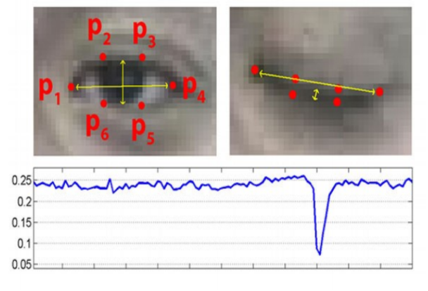
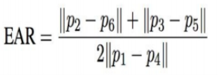
EAR(Eye Aspect Ratio) Calculation

Slide 10
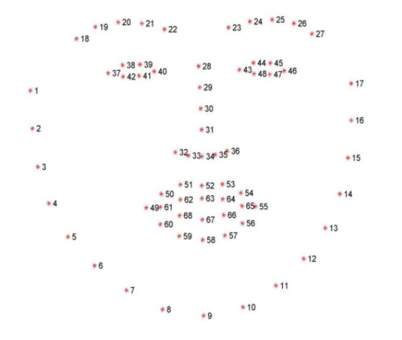
Dlib library

Slide 11
Python Libraries used in program
SciPy
Imutils
Threading
Numpy
Argparse
Time
Dlib
cv2

Slide 12
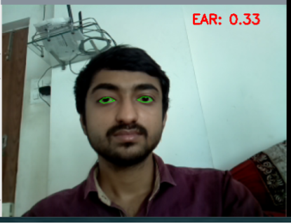
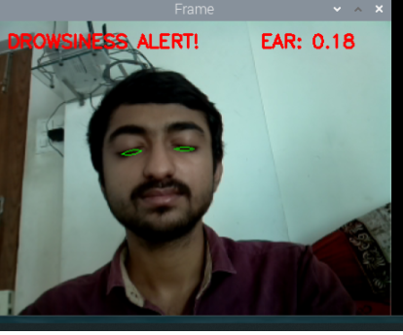
Test Results :- Without Eyeglasses

Slide 13
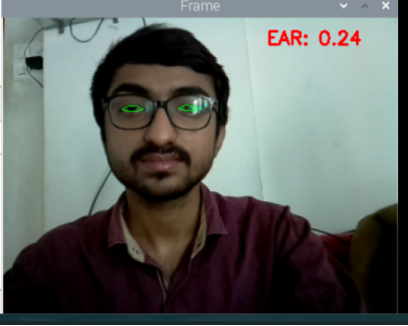
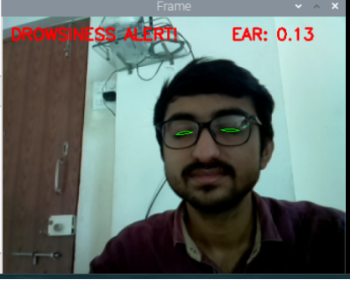
With Eyeglasses

Slide 14
Conclusion
Thus we would have successfully developed the Driver Drowsiness Detector using Python and OpenCv along with the a cam to detect the face.
Future Scope
It can also be use in public transport for monitoring drivers' condition and sending information to authority.
A picture of the burglar is taken in an attempted theft and sent to the owner of the vehicle who can register a case against the thief of the vehicle.

Slide 15
Thank You

